Slide 1
Bitte
Bitte hier den dunklen blauen Hintergrund nehmen, dann das Logo in weiß drauf
und DEINE NEUE DENKWIESE dazu schreiben – so wie wir das immer haben.

Slide 2
History of the Catholic Private University
In 1669 study programes in Philosophy and Church Law
In 1978, the Congregation for Catholic University Education upgraded the College to a full Theological Faculty
In year 2000 accreditation as Austria’s first private university
2005 the “Institute of Art and Philosophy” (IKP) was established
Since 2005 degrees in philosophy
In 2015 Establishment of the “Faculty of Philosophy and Art Studies”
Since 2015 degrees in art studies

Slide 3
Facts and Figures
2 Faculties / 3 Fields of Study: Theology, Philosophy and Art History
30 full-time staff, 20 part-time staff
450 students
the third largest library in Upper Austria with more than 255.000 books, 3.700 journals, incl. 500 current and 770 electronically retrievable journals

Slide 4
The characteristics of KU Linz
Excellence in scientific research
Interdisciplinary between the fields of study
Small group environment, great student-teacher ratio
Close supervision and support
Uniquely structured study programes
Focus on internationalization

Slide 5
Hier nehmen wir oben das KU Logo mit der Theologie, so wie auf der Fahne für den
Messestand – brauche ich dann auch als Seite für die Philosophie und die
Kunstwissenschaft.

Slide 6
Theology at the KU Linz is:
…rich in Tradition with a contemporary perspective
... Interdisciplinary - working closely with the Faculties of Philosophy and Art Studies
... Distinctive, addressing important societal issues, such as: ethics in business, art as a place of religious, philosophical, and ideological exchange, and secularism as a challenge for Christianity.
Notes:
Today the Faculty of Theology at the KU Linz sees its primary mission in the unification of the foundations and various traditions of the Christian faith. This shall serve to properly address the challenges of the modern world.

Slide 7
Studies
Diploma/ Licentiate / PhD Catholic Theology (Mag.theol. / 10 Sem, Lic.theol. / 4 Sem, Dr.theol. / 6 Sem)
Master Theology (MA / 4 Sem)
Master Religion in Culture and Society (MA / 4 Sem)- (honorary Professor Prof. Michael von Brück, Prof. Mouhanad Khorchide lecturing (University of Münster) and the Vienese Prof. Birgit Heller.
Bachelor Teaching Degree for Secondary Schools (BEd / 8 Sem)

Slide 8
PHD Studies
Catholic Theology, (Dr. theol.): 6 Semester
Art History and Philosophy (Dr. phil.) - 6 Semester
Advanced Theological Studies (PhD) - 6 Semester

Slide 9
Interdisciplinary Research Projects
“Business-Ethics-Society” -
investigating the relations of economy, ethics, and society, was integrated in the curriculum.
Research Group “Authenticity” –
a survey method to measure the impact of current transformations in the ongoing tensions between tradition, institution, and individual
Notes:
focuses on the investigation of the processes of transformation of the individual and society

Slide 10
Afiliated Research Institutes
Jaegerstaetter Institute founded 2017
Main goal: comprehend the biography and self-image of Franz Jaegerstätter, and contribute its life testimony to pedagogical, academic and socio-political concepts

Slide 11
Institute Fundamental Theology
Notes:
"Soziologie" und "Religionssoziologie",

Slide 12
Institute Church History
Project “ Personal Development”
Christian-based holistic personality education, which enables the individual to develop not only intellectually but also emotionally and spiritually

Slide 13
Berufsfelder Theologie
Religionsunterricht an allen Schultypen
Diözesan- oder Ordenspriester
PastoralassistentIn
PfarrassistentIn
Erwachsenenbildung
Wissenschaftliche Laufbahn
Personal- und Kulturmanagement
Medien- und Kommunikationsbereich

Slide 14
Philosophy
The Faculty of Philosophy at the KU Linz has three chairs:
Theoretical Philosophy
History of Philosophy
Practical Philosophy/Ethics

Slide 15
Studies
Bachelor Art History – Philosophy (BA / 6 Sem)
Master Art History – Philosophy (MA / 4 Sem)
Master Philosophy (M.phil. / 4 Sem)
PhD Art History – Philosophy (Dr.phil. / 6 Sem)
Teaching Degree for Secondary Schools (BEd / 8 Sem) Subjects Psychology und Philosophy

Slide 17
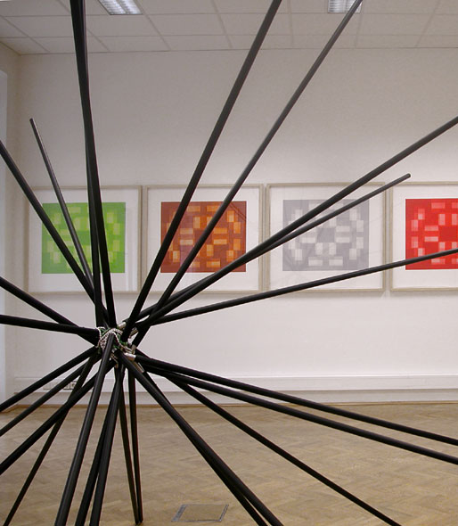
Art History
Focuses on modern and contemporary art and architecture from around 1800 to the 21st century
Global, transcultural and trans-religious perspectives
Contemporary Arts, Media and Technology

Slide 18
Studies
Bachelor Arts History – Philosophy (BA / 6 Sem)
Master Arts History – Philosophy (MA / 4 Sem)
Master Philosophy (M.phil. / 4 Sem)
Master Arts History (MA / 4 Sem)
PhD Arts History – Philosophy (Dr.phil. / 6 Sem)
Teaching Degree for Secondary Schools (BEd / 8 Sem)

Slide 19
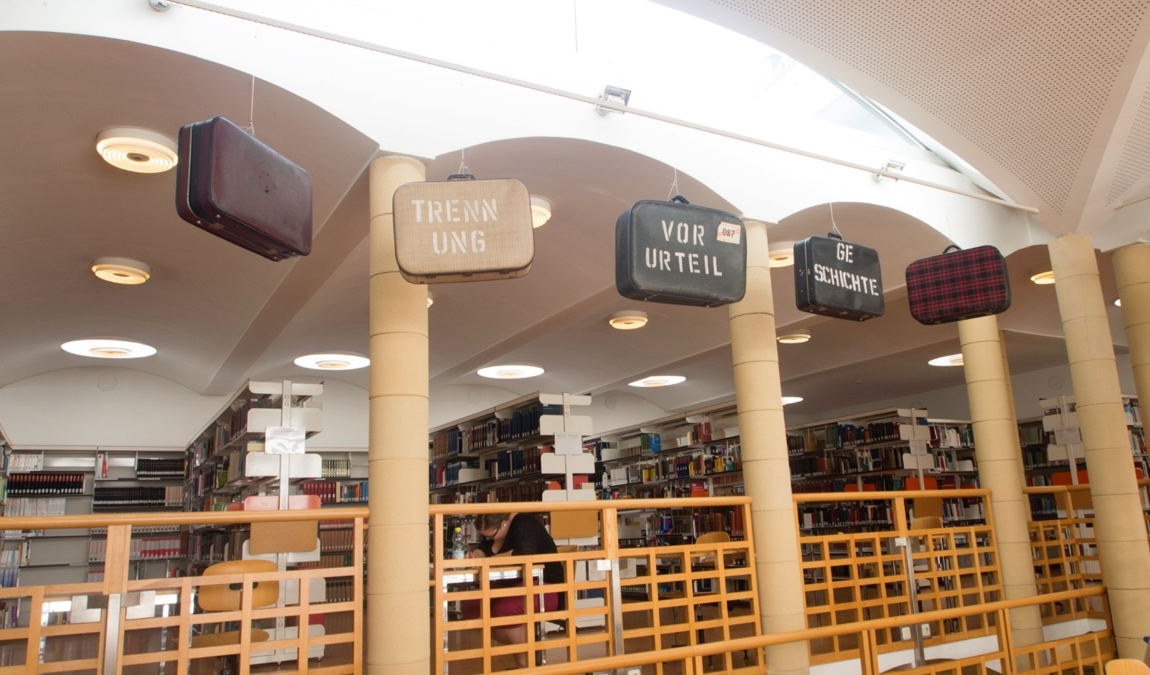
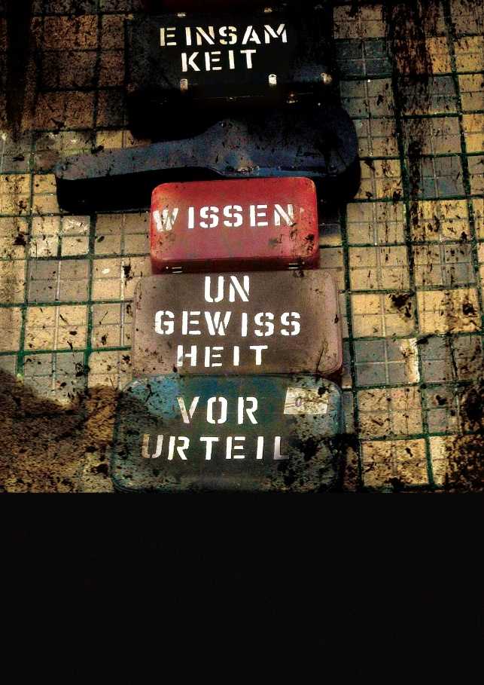
ESIN TURAN
Emigrant Suitcase. Two Oranges and a Fistful Sugar, Ready Made Installation with 15 suitcases, 2005

Slide 20
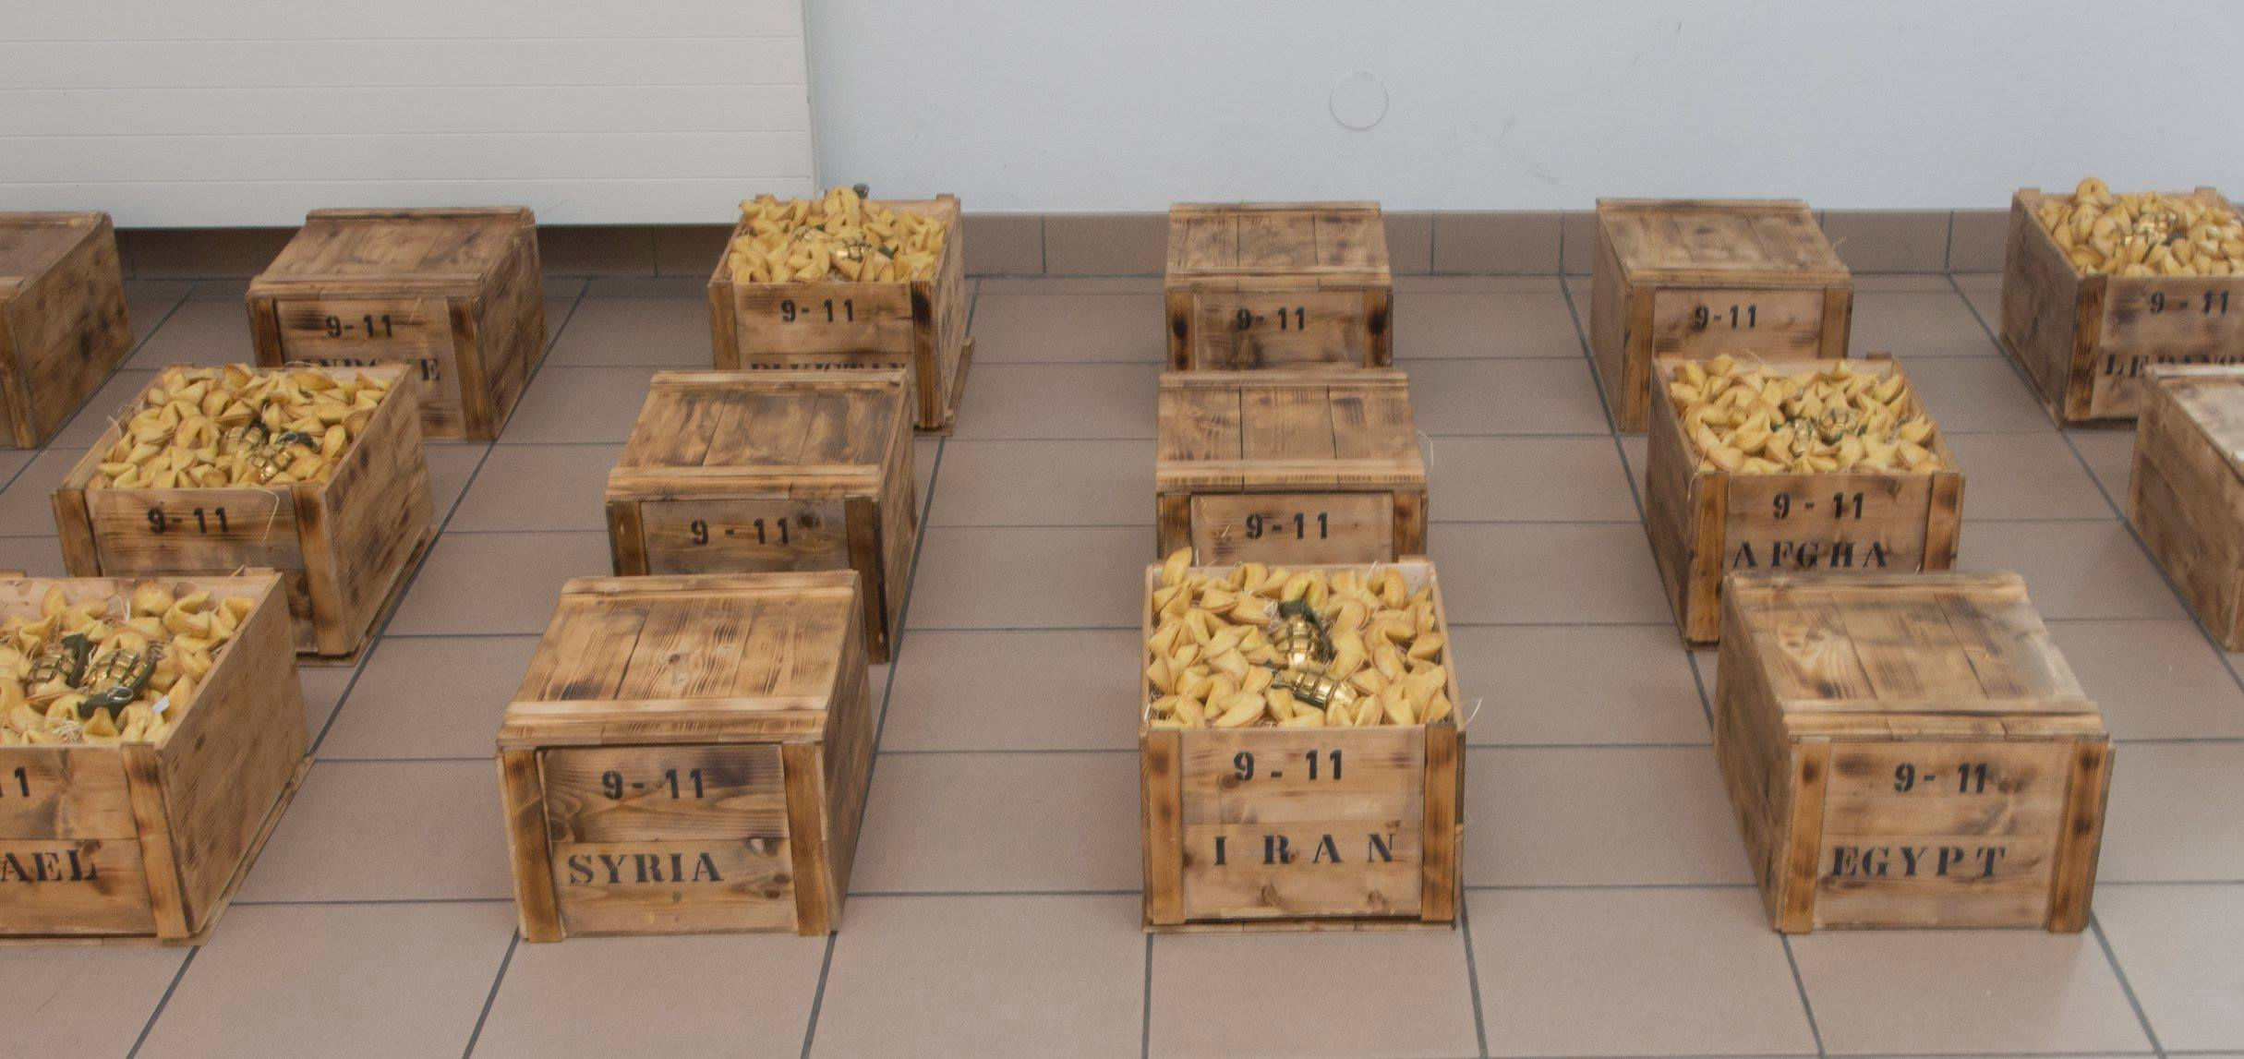
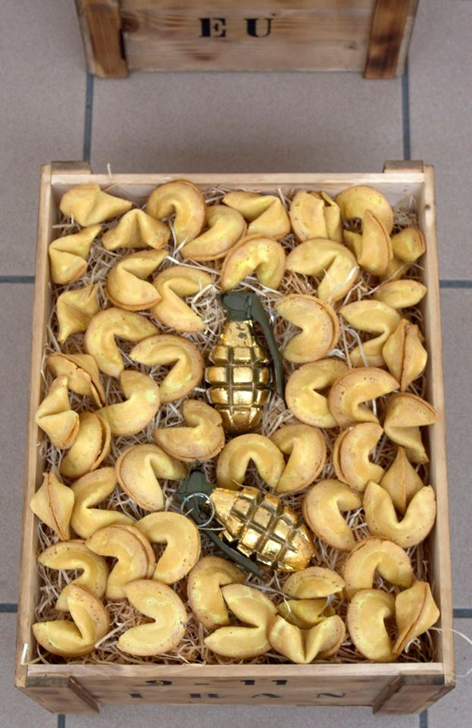
ESIN TURAN
Explosive Fortunes, Installation with 16 wooden boxes, fortune cookies and gold-plated granades, 2007 (Koncept 2001)

Slide 21
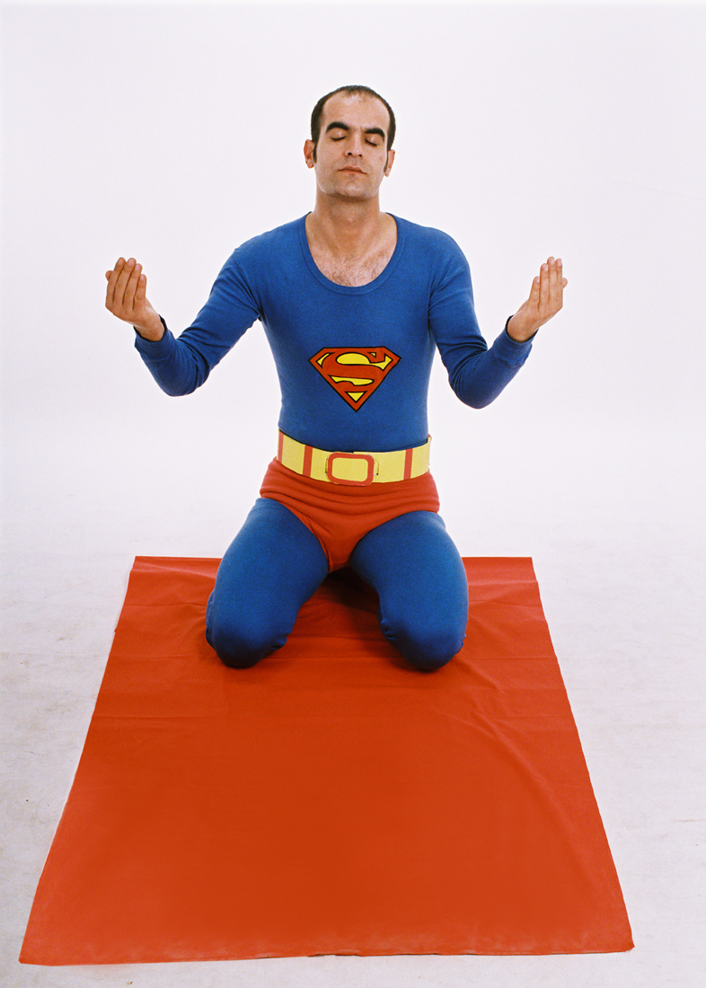
GLOBAL ART HISTORY
Away from the traditional western view of art „The West and the Rest“. The current focus of the symposium „Global Art History“ the is on islam, transcultural art and migration
Şener Özmen, Supermuslim, 12 C-print Fotografie, 50 x 70 cm, 2003, Pilot Gallery/Istanbul

Slide 22
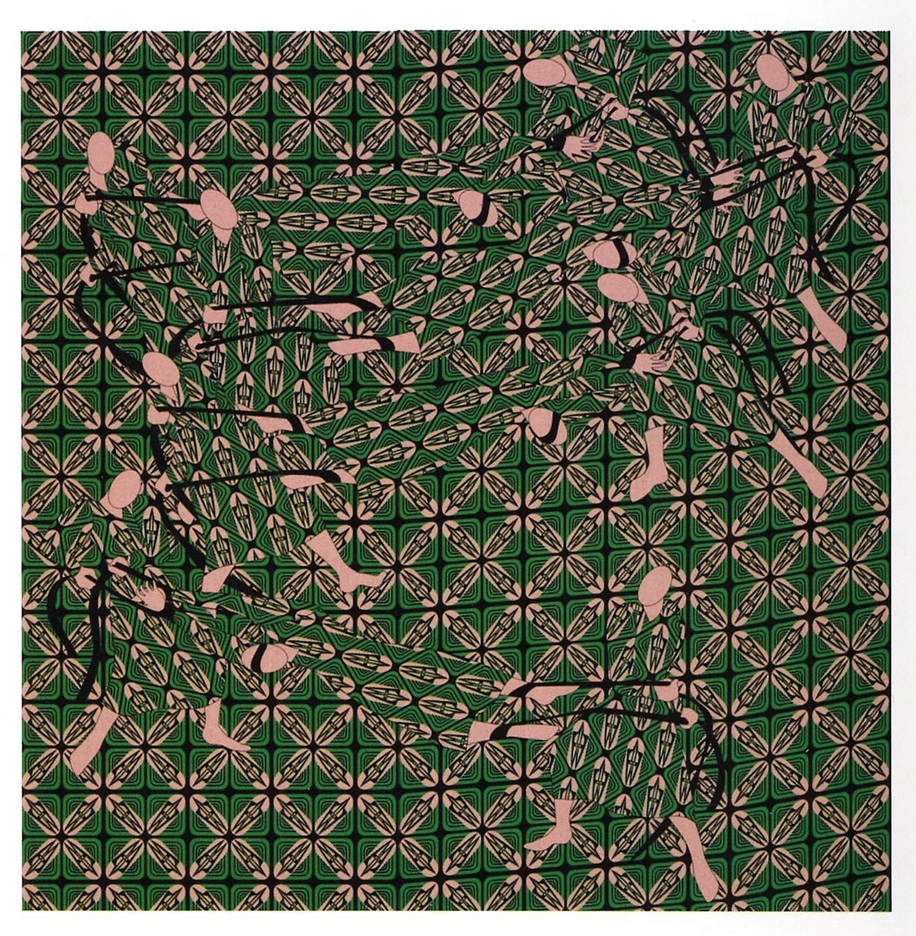
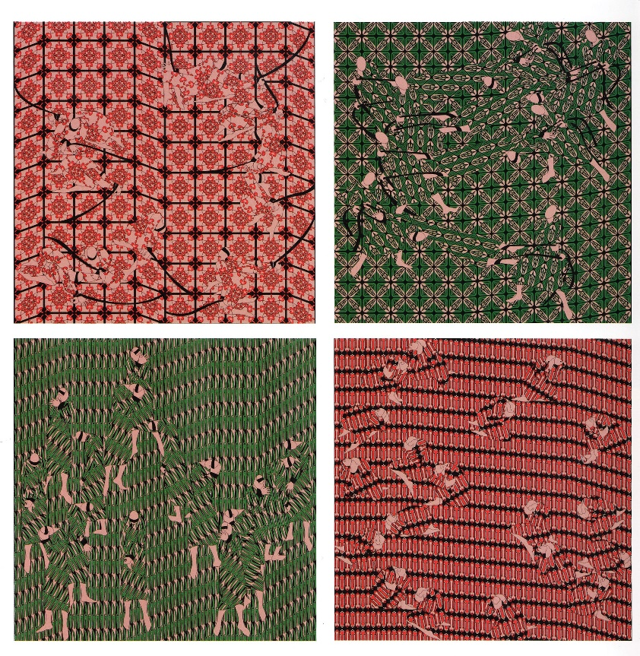
Dissertation Project Susanne Winder
Parastou Forouhar: Digitale Zeichnungen und Installationen. Ornament und Methode. (AT)
Parastou Forouhar, Rot ist mein Name Grün ist mein Name, Karree, 2008, Digitaldruck auf Aludibond, jeweils 80x80 cm
<= Detail

Slide 23
KU International

Slide 24
Partner
Armenia
State Academy of Fine Arts
Belgium
Katholieke Universiteit Leuven
Croatia
University of Osijek
Czech Republic
University of South Bohemia
France
Catholic University of Paris
Catholic University of Toulouse
Germany
Freie Universität Berlin
Humboldt-Universität zu Berlin
Albert-Ludwigs University of Freiburg
Theologische Fakultät Fulda
Katholische Fachhochschule Mainz
Westfälische Wilhelms-Universität Münster
University of Tuebingen
Katholische Universität Eichstätt-Ingolstadt
Greece
Aristotle University of Thessaloniki
Hungary
Sapientia College of Theology
Gál Ferenc College
Italy
Accademia di Belle Arti di Brera
Università degli Studi di Roma 'La Sapienza'
University of Udine
Jordan
Yarmouk University
Norway
VID Specialized University
Romania
Universitaea de Vest din Timisoara
Spain
University of Salamanca
Turkey
Dicle University
Trakya University
Süleyman Demirel University
Aralik Univertisesi

Slide 25
Exchange Semester at the KU Linz
Students from the JCU
can spend one or two semesters at the KU Linz:
Attending classes from all fields of study (in German)
Working on their final thesis with a tutor from KU Linz (in English or German)
Joining our KULIS- International KU Linz Semester in Autum Term 2019/20 (in English)

Slide 26
KULIS 2019/20
30 ECTS Points
Two orientation weeks:
16th of September- 30th of September
Semester:
1st of October-30th of January

Slide 27
KULIS
Two Orientation Weeks bevor the semester starts, including:
Sightseeing and Get-Together Events
• Intensive German Course (3 ECTS)
• Cross-Cultural Communication Course (2 ECTS)
• Guided field trips to The Mauthausen Memorial, the Benedictine Monasteries at Kremsmünster, Admont (with the largest monastery library of the world), and Melk, the Bruckner Organ at St. Florian Monastery (3 ECTS), etc.
KU Linz Buddy Program during the whole stay

Slide 28
KULIS- Semester Courses
• The Impact of Religions and Value Systems on European Cultures
• Ethics and Society
• Freedom of Will
• Introducing Old Testament Theologies
• Exegesis of Selected New Testament Texts
• Material Culture in Art and Religion
• German Language Course

Slide 29
KULIS Academic Year 2019/20
Experience a multidisciplinary and multicultural study environment in Linz, Austria!

Slide 30
LINZ
the third-largest city of Austria and capital of the state of Upper Austria
located in the northern part of Austria, about 30 kilometers south of the Czech border, on both sides of the River Danube
population is about 200,000
best known for its high-tech innovations and its contemporary art scene

Slide 31
Linz

Slide 32
Linz

Slide 33
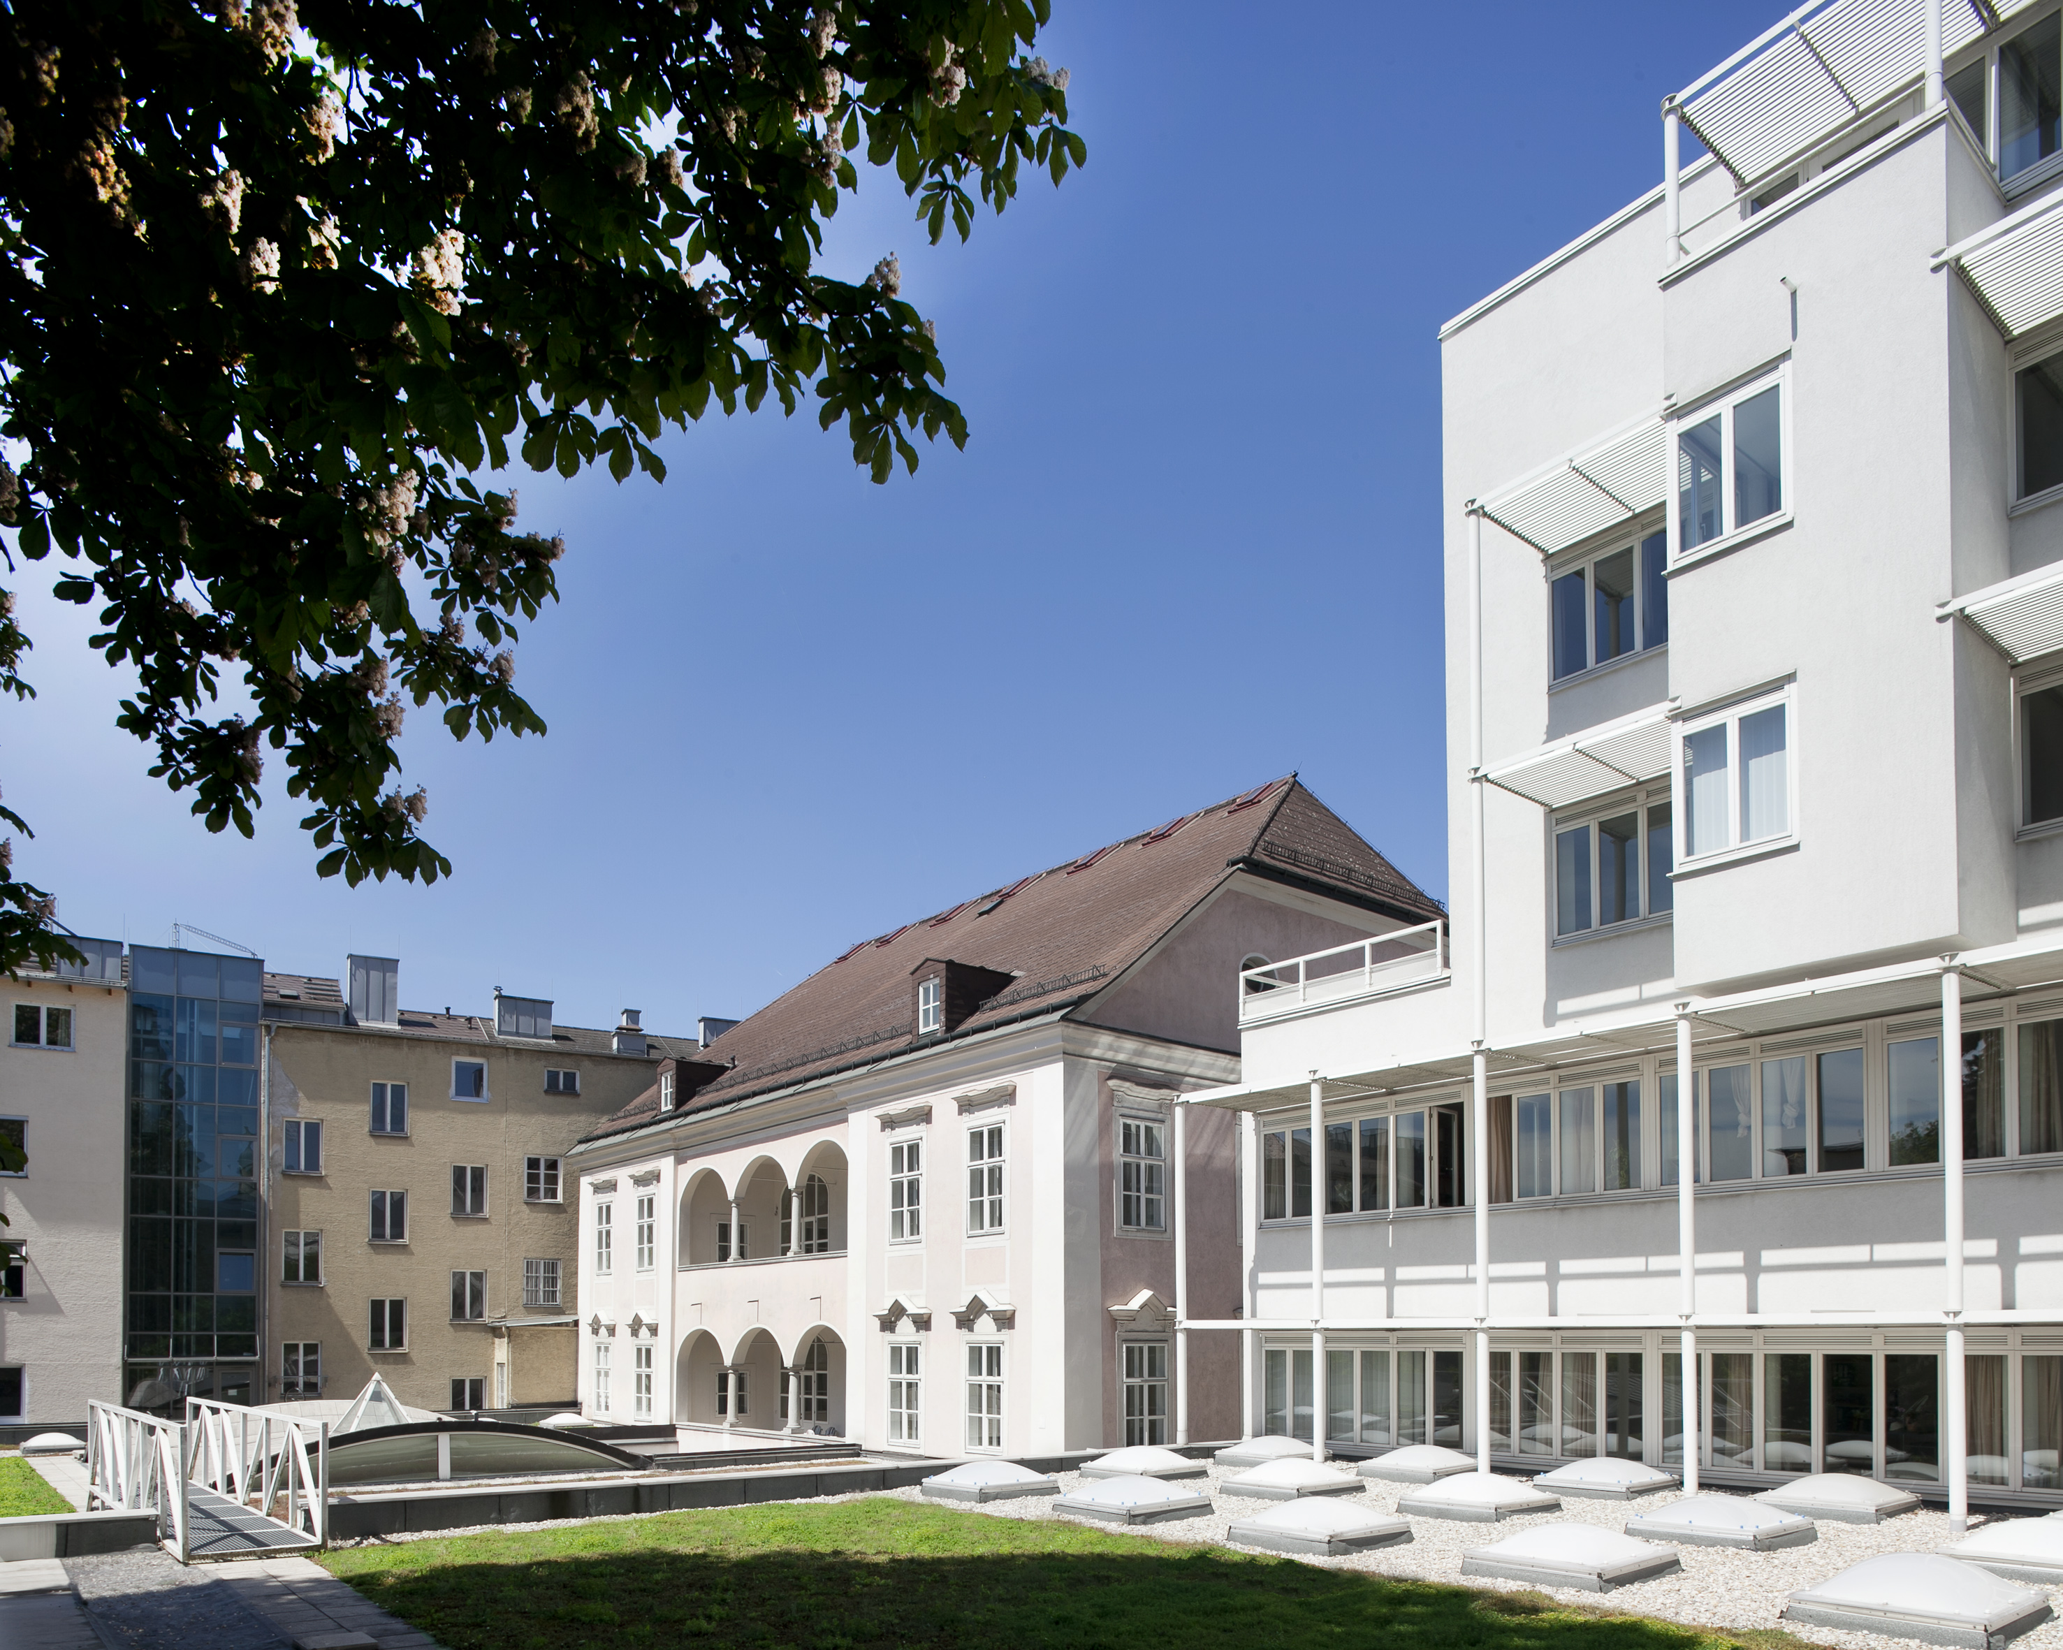
Contact
Mag. Angelina Kratschanova, EMBA
Director of International Relations and Project Services
Katholische Privat-Universität Linz
A-4020 Linz, Bethlehemstraße 20
T: +43 732 78 42 93 4153
M: +43 677 61257711
E: a.kratschanova@ku-linz.at

Slide 34
The KU Linz hope to welcome you soon at the KU Linz!

